Slide 1

A MINI PROJECT ON
AI Game with Reinforcement learning
UNDER THE GUIDENCE OF PRESENTED BY,
Mr.G.Arun Batch Number:21PA04
(Associate professor) A.V.S.Karthik(21P61A0514)
A.Indhu(21P61A0507)
A.Charan(21P61A0508)

Slide 2
CONTENTS
Abstract
Introduction
Literature Survey
Research Gap and Challenges
Problem statement
Objective
Proposed Methodology
Software and Hardware requirements
References

Slide 3
ABSTRACT
AI Game using reinforcement learning project explores the development of an AI-driven game utilizing reinforcement learning (RL) techniques to create an intelligent agent capable of autonomously navigating a dynamic environment. The game environment is designed as a grid-based space, featuring various elements such as obstacles, rewards, and enemies, where the agent’s objective is to maximize its cumulative reward by reaching a goal state while avoiding hazards.
The core of the project is the implementation of a reinforcement learning algorithm, particularly Deep Q-Learning (DQL), which enables the agent to learn optimal strategies through trial and error interactions with the environment. The agent’s learning process is guided by rewards for successful actions, such as reaching the goal, and penalties for unfavorable outcomes, such as colliding with an enemy.

Slide 4
INTRODUCTION
s.
.
The rapid advancement of artificial intelligence (AI) has profoundly transformed the video game industry, enabling the creation of intelligent agents that can learn, adapt, and evolve within complex environments. Among various AI techniques, reinforcement learning (RL) stands out as a powerful method for training agents to make decisions based on their experiences, resulting in increasingly sophisticated and human-like gameplay.
AI Game aims to leverage the potential of reinforcement learning to develop an AI-driven game focused on teaching an agent to navigate a challenging environment. The agent's objective is to reach a designated target while skillfully avoiding obstacles and adversaries.

Slide 5
LITERATURE SURVEY
Author(s) | Title | Year | Key Concepts | Relevance to Project
Mnih, V., Kavukcuoglu, K., Silver, D., et al. | Human-level control through deep reinforcement learning | 2015 | Deep Q-Learning (DQL), Atari games, Learning from raw pixel data | Introduces DQL, a core method for your project, showing how reinforcement learning can be applied to game environments for intelligent decision-making.
Sutton, R. S., & Barto, A. G. | Reinforcement Learning: An Introduction | 2018 | Exploration vs Exploitation, Q-learning, Policy Gradient Methods | Provides foundational knowledge of reinforcement learning techniques, key for training the AI agent in your game.
Silver, D., Schrittwieser, J., Simonyan, K., et al. | Mastering the game of Go without human knowledge | 2017 | Self-play, Reinforcement Learning, AlphaGo, Complex Decision Making | Demonstrates reinforcement learning applied to a complex game (Go), illustrating how agents can learn strategies from scratch.

Slide 6
Author(s) | Title | Year | Key Concepts | Relevance to Project
Bellemare, M. G., Naddaf, Y., Veness, J., & Bowling, M. | The Arcade Learning Environment: An evaluation platform for general agents. | 2013 | Game AI evaluation, Generalization, Performance Benchmarks. | Highlights benchmarks for evaluating AI agents, relevant for testing your AI in various game environments and measuring its adaptability.
Yannakakis, G. N., & Togelius, J. | Artificial Intelligence and Games | 2018 | AI in game design, Player modeling, Adaptive gameplay | Offers insights into using AI to create dynamic, engaging, and adaptive gameplay, aligning with the goal of making gameplay less predictable and more immersive.
Kober, J., Bagnell, J. A., & Peters, J. | Reinforcement Learning in Robotics: A Survey | 2013 | Policy learning, Real-time adaptation, Model-based and model-free RL | Discusses real-time adaptation, crucial for creating an AI agent that can adjust its strategies in your dynamic game environment.

Slide 7
Author(s) | Title | Year | Key Concepts | Relevance to Project
Lillicrap, T. P., Hunt, J. J., Pritzel, A., et al. | Continuous control with deep reinforcement learning | 2016 | Actor-Critic methods, Continuous action spaces, Deep Deterministic Policy Gradient (DDPG) | Introduces the DDPG algorithm, useful for continuous action spaces, which can be adapted for more fluid, real-time decisions in games.
Zhang, S., & Sutton, R. S. | A Deeper Look at Experience Replay | 2017 | Experience Replay, Q-learning, Sample efficiency | Discusses how experience replay improves the stability and efficiency of Q-learning, a key component in training AI for dynamic environments.
OpenAI, Berner, C., Brockman, G., et al. | Dota 2 with Large Scale Deep Reinforcement Learning | 2019 | Large-scale multi-agent RL, Complex environments, Self-play | Describes how reinforcement learning is applied in multi-agent settings for complex games like Dota 2, offering insights into scalable RL techniques.

Slide 8
PROBLEM STATEMENT
Traditional game AI often relies on static algorithms and predefined rules, resulting in predictable and less immersive gameplay. This project aims to address this limitation by developing an AI agent that learns from its experiences and dynamically adapts its strategies in real time. The challenge lies in effectively training the AI to manage the balance between exploration and exploitation while maintaining robust and engaging gameplay.

Slide 9
OBJECTIVE
Develop an AI Agent: Create an intelligent agent capable of learning and adapting to a dynamic game environment using reinforcement learning techniques.
Enhance Gameplay Experience: Aim to create a game that offers engaging and dynamic gameplay, showcasing the capabilities of the AI agent in navigating challenges.

Slide 10
PROPOSED METHODOLOGY
The development of the AI-driven game will follow a structured methodology, consisting of several key phases:
Problem Definition and Environment Design
Reinforcement Learning Model Selection
Agent Training
Scenario Development and Testing
Performance Evaluation and Optimization
Documentation and Analysis

Slide 11
SOFTWARE AND HARDWARE REQUIREMENTS
RAM: 4GB
Hard Disk: At least 1GB of free Hard Disk space
Operating System: Windows 8/10
Coding Language: Python
IDE: Visual Studio
Libraries and Frameworks: PyTorch, Numpy, Pygame

Slide 12
MODULES
Environment Setup: Implement game elements (player, enemies, goal) as objects, set grid size, and initialize the environment for agent interaction.
Agent Design: Define agent properties (state, actions), reward functions, and establish interactions with the environment.
Reinforcement Learning Algorithm: Develop the agent’s learning model using Deep Q-Learning or another reinforcement learning method.
Game Simulation and Testing: Run simulations to assess the agent’s performance in various scenarios.
Documentation and Reporting: Document the code, training process, and results.

Slide 13
Implementation
Step 1: Design the Environment
Create a grid-based environment that represents the game board.
Define the entities:
Player (Agent): Starts at a random position on the grid.
Goal: Fixed or random position; the agent aims to reach it.
Enemies/Obstacles: Static or dynamic positions; the agent must avoid them.
Assign each grid cell a value to represent the entities (e.g., 1 for player, 2 for goal, -1 for enemies, 0 for empty spaces).

Slide 14
Step 2: Define the Action Space
Define the possible actions the agent can take:
Up, Down, Left, Right
Ensure the agent’s movement respects the grid boundaries and does not go outside the environment.
Step 3: Represent the State
Encode the game environment as a matrix (2D array).
Use this matrix as the current state that the agent observes.
The state includes:
The agent’s position.
Positions of the goal and enemies.

Slide 15
Step 4: Implement the Reward System
Assign rewards to actions based on the outcomes:
+10 for reaching the goal.
-10 for colliding with an enemy.
-1 for each step taken (to encourage efficiency).
Step 5: Implement the Q-Learning Algorithm
Initialize the Q-Table (a matrix to store Q-values for each state-action pair) with zeros.

Slide 16
Step 6: Train the Agent
Run multiple episodes where the agent interacts with the environment.
Update the Q-Table or Q-Network weights based on feedback from rewards and penalties.
Step 7: Evaluate the Agent
Test the trained agent in the environment:
Measure how well it avoids enemies and reaches the goal.
Analyze its behavior in unseen configurations of the environment.

Slide 17
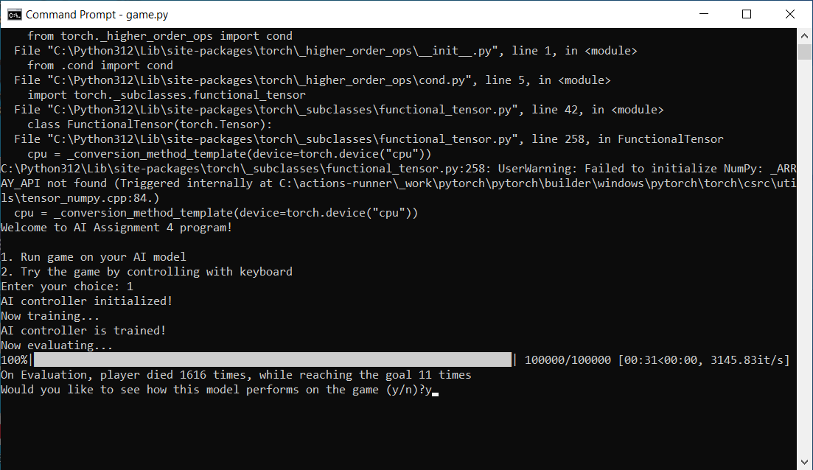
Results

Slide 18
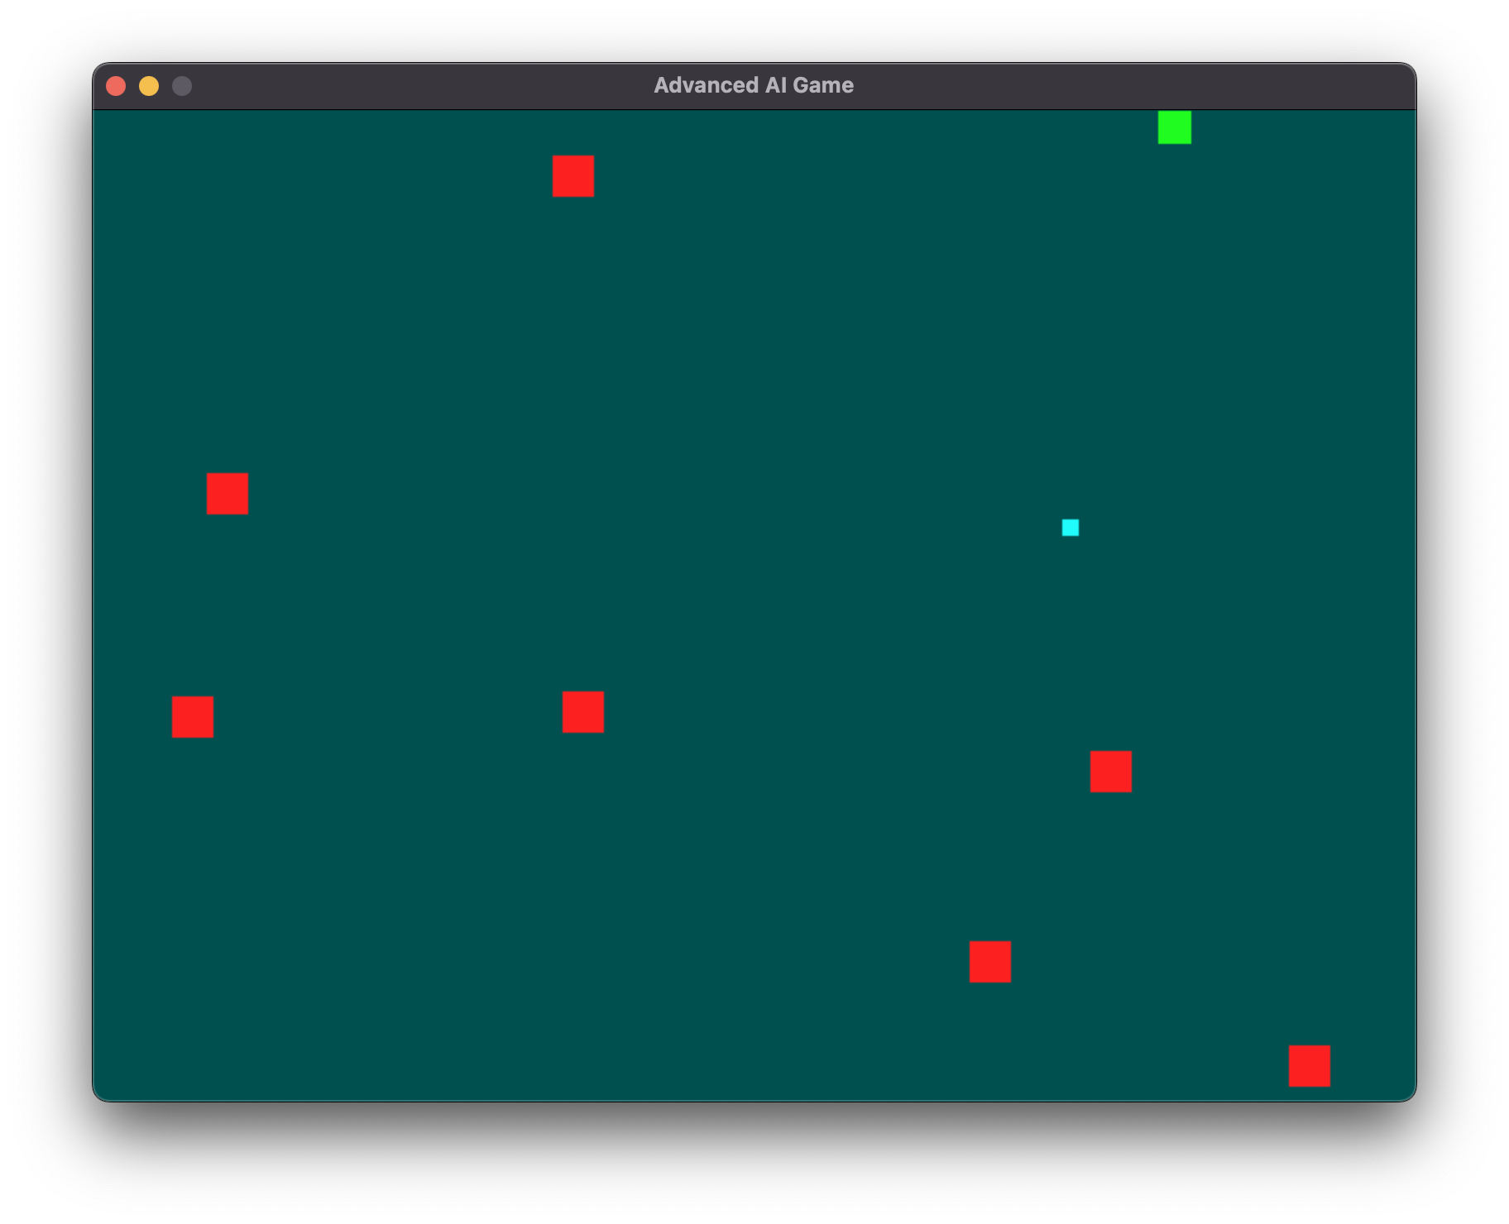

Slide 19
REFERENCES
Mnih, V., Kavukcuoglu, K., Silver, D., et al.,Human-level control through deep reinforcement learning.
Sutton, R. S., & Barto, A. G. Reinforcement Learning: An Introduction
Silver, D., Schrittwieser, J., Simonyan, K., et al.,Mastering the game of Go without human knowledge.
Bellemare, M. G., Naddaf, Y., Veness, J., & Bowling, M., The Arcade Learning Environment: An evaluation platform for general agents.
Yannakakis, G. N., & Togelius, J.,Artificial Intelligence and Games.
Kober, J., Bagnell, J. A., & Peters, J.,Reinforcement Learning in Robotics: A Survey.
Lillicrap, T. P., Hunt, J. J., Pritzel, A., et al.,Continuous control with deep reinforcement learning.
Zhang, S., & Sutton, R. S., A Deeper Look at Experience Replay
OpenAI, Berner, C., Brockman, G., et al., Dota 2 with Large Scale Deep Reinforcement Learning.
Schulman, J., Wolski, F., Dhariwal, P., et al., Proximal Policy Optimization Algorithms.

Slide 20
Thank You

